Slide 1
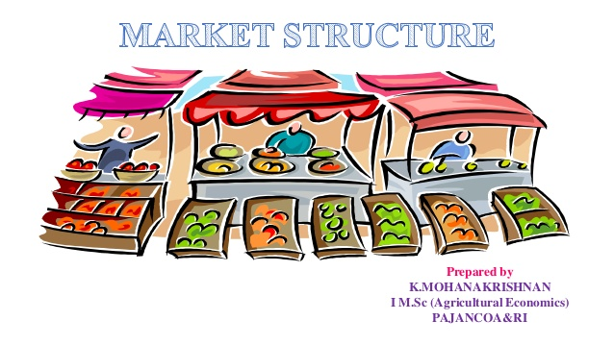
Market Structures
Zahid Gulzar

Slide 2
Market in Economics
No reference to a particular place
The buyers & sellers need not assemble anywhere
An ordinary post, telephone, mail can serve the channel
Commercial interaction
Matching of demand and supply
Same things, Same price, Same time

Slide 3
Definition
A market implies an interaction between a buyer and a seller at a point in time so that the transaction is successful and market clear.

Slide 4
Classifications
Geographic Proximity
Local Market
Regional Market
National Market
International/Global market

Slide 5
(ii) Functional Proximity
General Markets
Mixed Markets
Specialized Markets

Slide 6
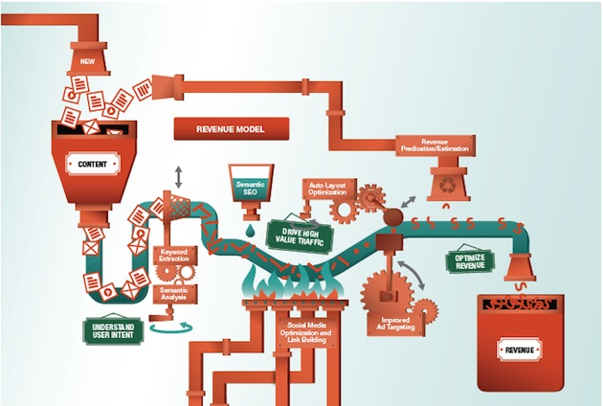
(iii) Competition Proximity
Perfect Markets
Imperfect Markets

Slide 7
PERFECT COMPETITION
Features/Assumptions
Large no. of Buyers and Sellers
Product Homogeneity
Free Entry & Exit of Firms
Profit Maximization
No Govt. regulations
---------Pure Competition--------
(vi) Perfect Factor Mobility
(vii) Perfect Knowledge

Slide 8
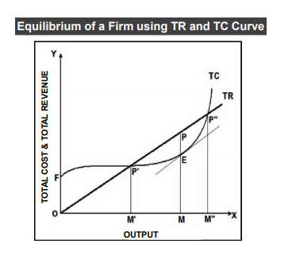
Equilibrium of Firm in Short-Run
Eq is when Profit
is maximised.
ƛ = R-C
TR-TC Approach

Slide 9
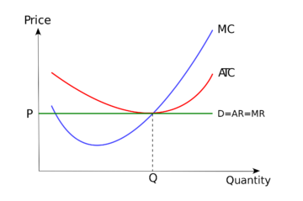
MR-MC Approach
MC=MR
Slope of MC > Slope of MR

Slide 10
Equilibrium of Industry in Short-Run
Summation of Firms
Steady Output
No Expansion or Contraction of Output
Industry Equilibrium means Ʃ of Individual Firms Equilibrium
Earning only Normal Profits
SMC = MR = AR = SAC
Qd = Qs; Market is Cleared
(B) Excess Profit Firms
(C) At Loss Firms

Slide 11
Long-Run Equilibrium of a Firm
Conditions:
SMC = LMC = MR = AR = P = SAC = LAC at its minimum point
LMC curve must cut MR curve from below
The firm can change its plant and scale of operations.
All costs are variable costs
Firms earn normal profits
Firms do not want to change their output
Firms produce at the minimum point of their long-run AC curve

Slide 12
Long-Run Equilibrium of Industry
The industry is in equilibrium in the long-run when all firms earn normal profits.
LMC = MR = AR (-P) = LAC at its minimum.
Total Demand = Total Industry Supply.
No incentive for firms to leave the industry or for new firms to enter it.
If both the industry and the firms are in long-run equilibrium, they are also in short-run equilibrium.

Slide 13
Example of Perfect Competition
Agricultural Markets
Free Software
Street Vendors

Slide 14
Efficiency
PC is always an efficient market
Optimal allocation of resources
No Consumer’s or Producers Surplus accrues
Output is produced at minimum feasible cost
Price = Opportunity Cost; No rents
Full Capacity use of plants in long run, no wastage of resources

Slide 15
Monopoly
Features/Assumptions
Single seller (Industry)
Price Maker
No close substitutes
Full control of the raw material
Barriers to entry

Slide 16
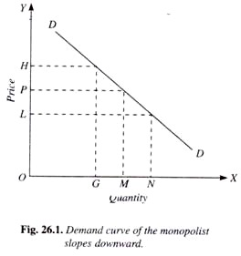
Demand
Firm’s demand curve is industry demand curve
Assumed to be known
Downwards sloping
To sell an additional unit, the firm must decrease its price

Slide 17
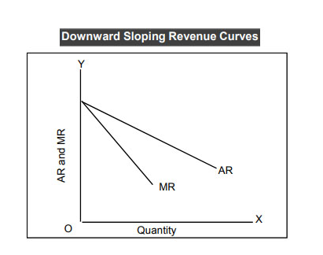
Downward sloping Average and Marginal Revenue Curves
As the price decreases, Quantity demanded increases
To increase sales a Monopolist has to decrease the price;
Making the current customers purchase more
Inducing new customers to enter the market
Revenue
Curves

Slide 18
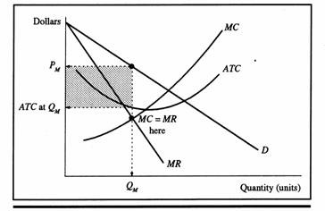
Costs
A Monopolist sells at a higher cost
Less consumer’s surplus
Higher producer’s surplus

Slide 19
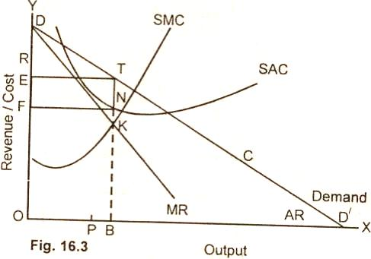
Short-Run Equilibrium of Monopolist
Conditions:
MC is equal to MR
Slope MC > Slope of MR
At the point of
intersection
Excess Profit = FNTE

Slide 20
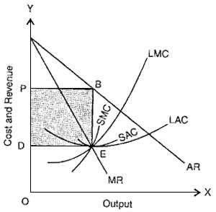
Long-Run Equilibrium of a Monopolist
Expand his plant
Usually earns super-normal profit
Leaves business if losses are made

Slide 21
Degrees of Monopoly
3 Degrees of Price Discrimination
First Degree Price Discrimination
> Extreme end
> Each Customer different price
> No consumer’s surplus
Second Degree Price Discrimination
> Different price to different groups

Slide 22
(iii) Third Degree Monopoly
> The market is divided into sub-markets
> Price charged accordingly

Slide 23
Example
Indian railway
Zenith Fibres Ltd

Slide 24
Thank You
zahideconomics49@gmail.com

